Slide 1
Discussion 3 File Organizations
Xie chenghuan

Slide 2
File Organization
Different DB Files Structures
Heap Files: a file with no order enforced.
不要看到Heap就认为是有序的
Sorted Files: a file with order enforced.

Slide 3
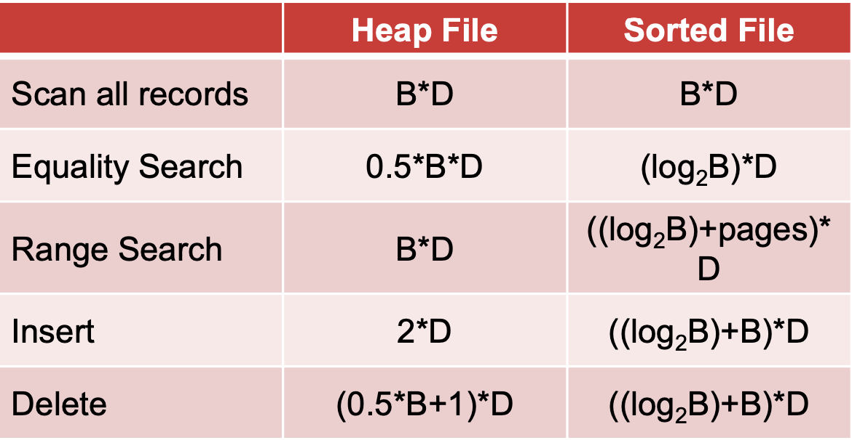
Cost of Operations（平均复杂度）
B: The number of data blocks
R: Number of records per block
D: Average time to read/write disk block

Slide 4
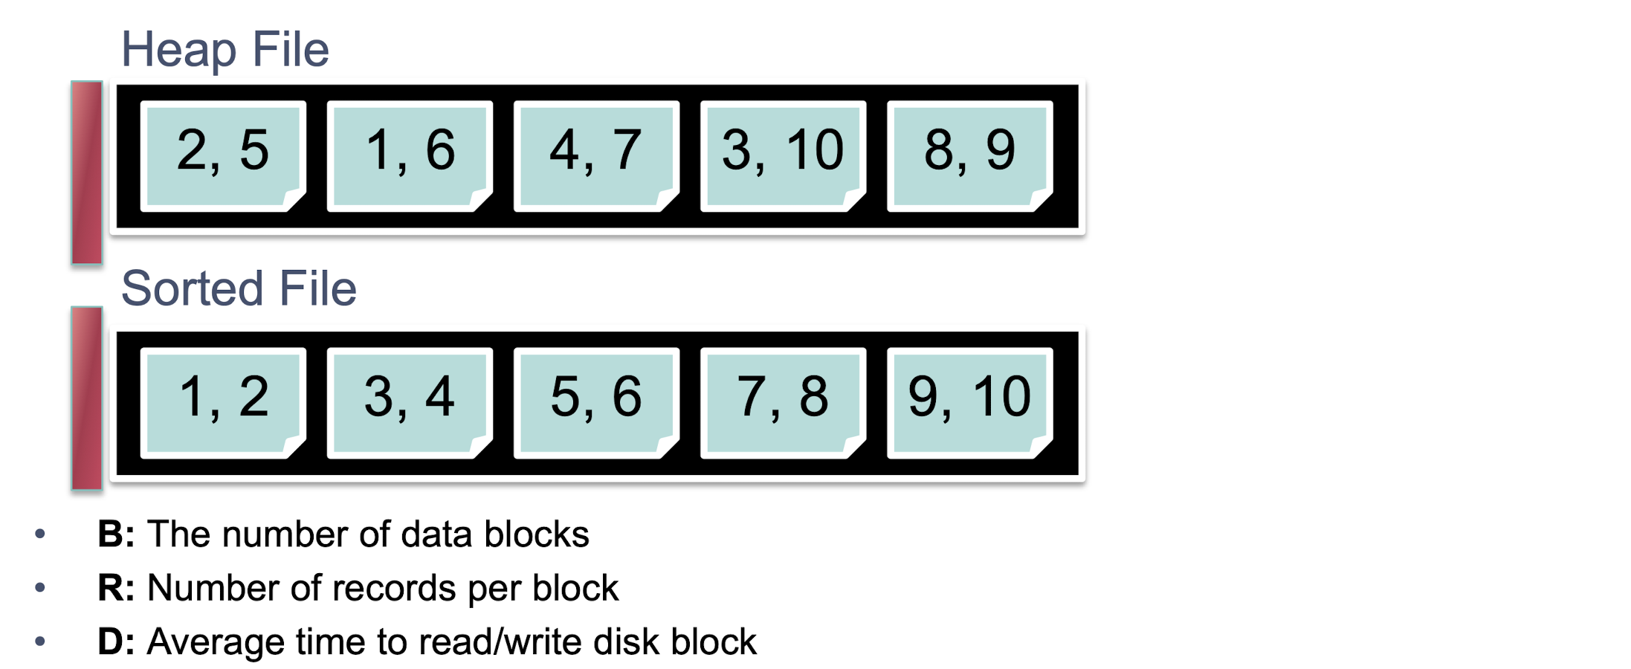
Cost of Operations（平均复杂度）

Slide 5
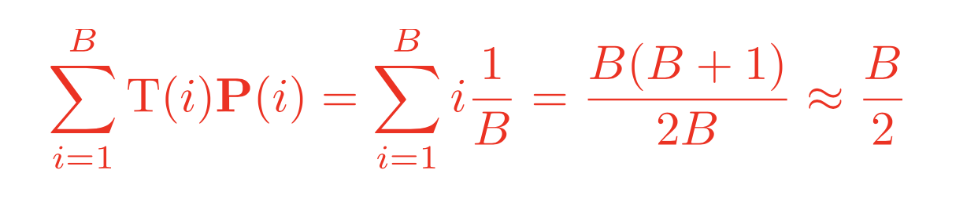
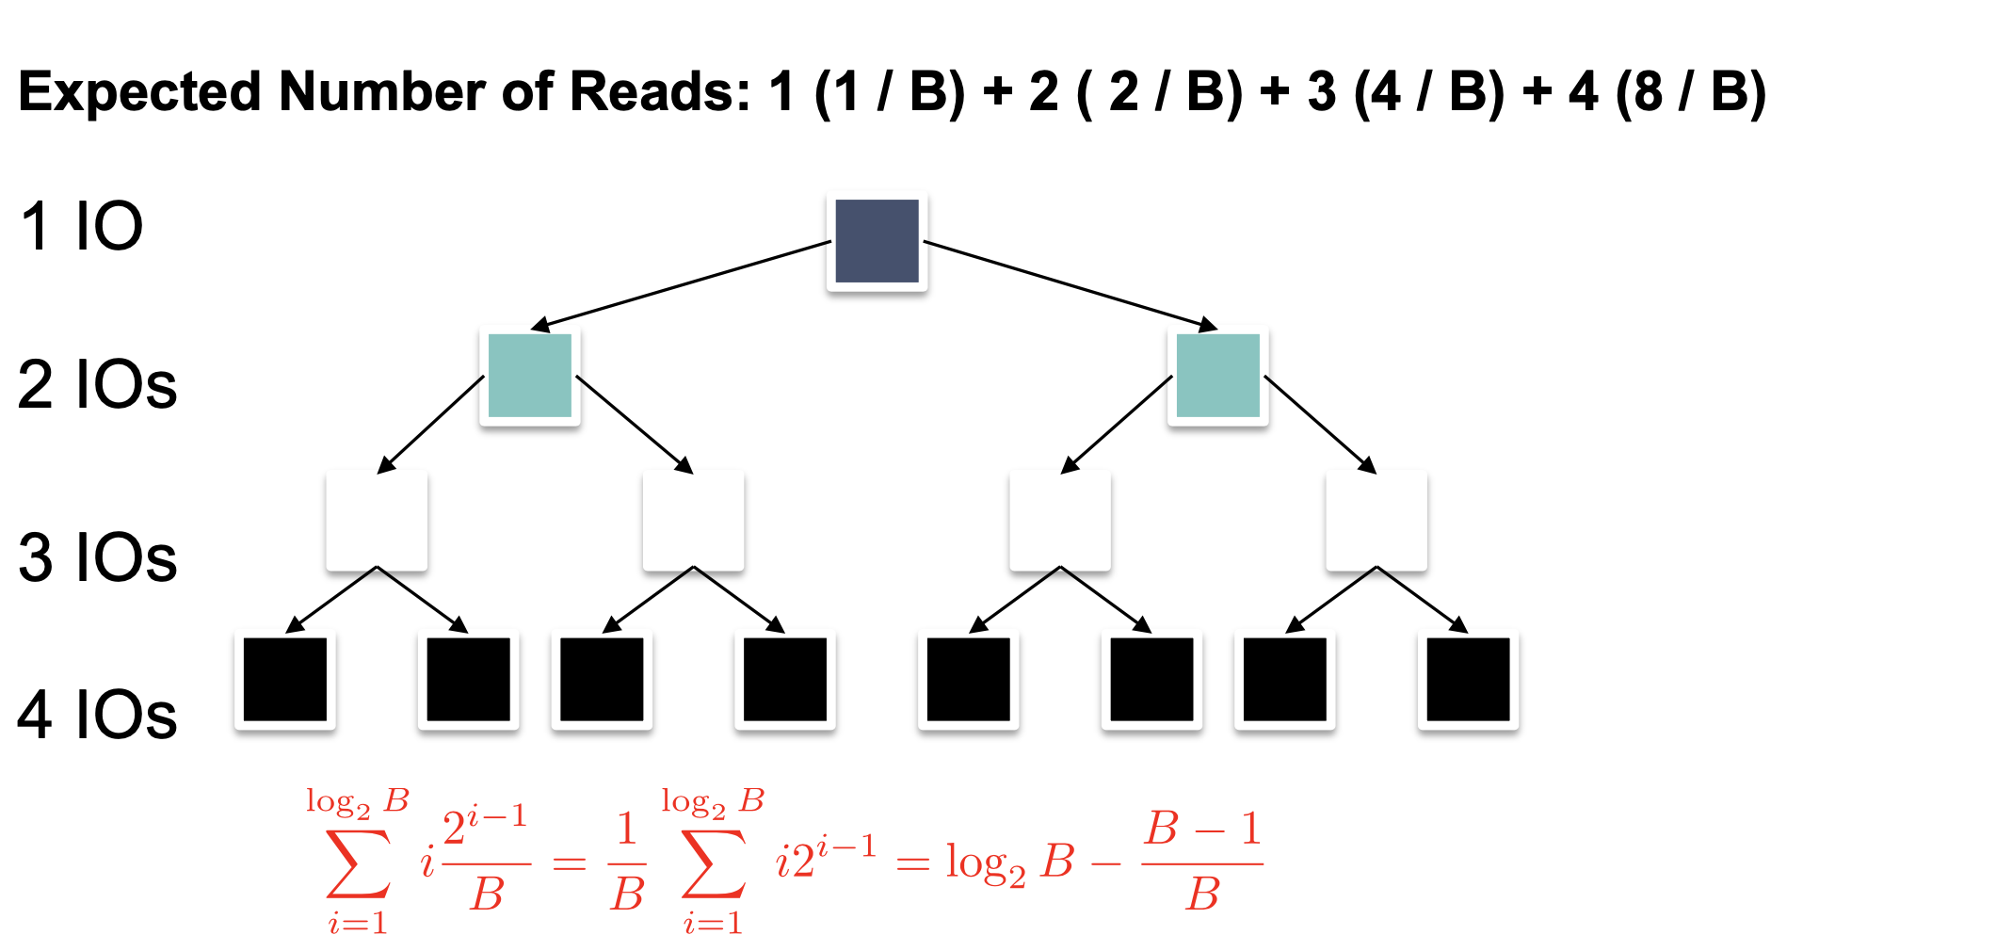
0.5*B*D
(log₂B)*D

Slide 6
((log₂B)+pages)* D pages涉及到的个数
Sorted file: 7,7 7,7 7,7 7,7 7,7
((log₂B)+B)*D
(read+write)*(0.5*B*D)=2*(0.5*B*D)=B*D
(0.5*B+1)*D heap file 可以有空间碎片，所以只需要写回到硬盘
write*D=1*D

